Slide 1
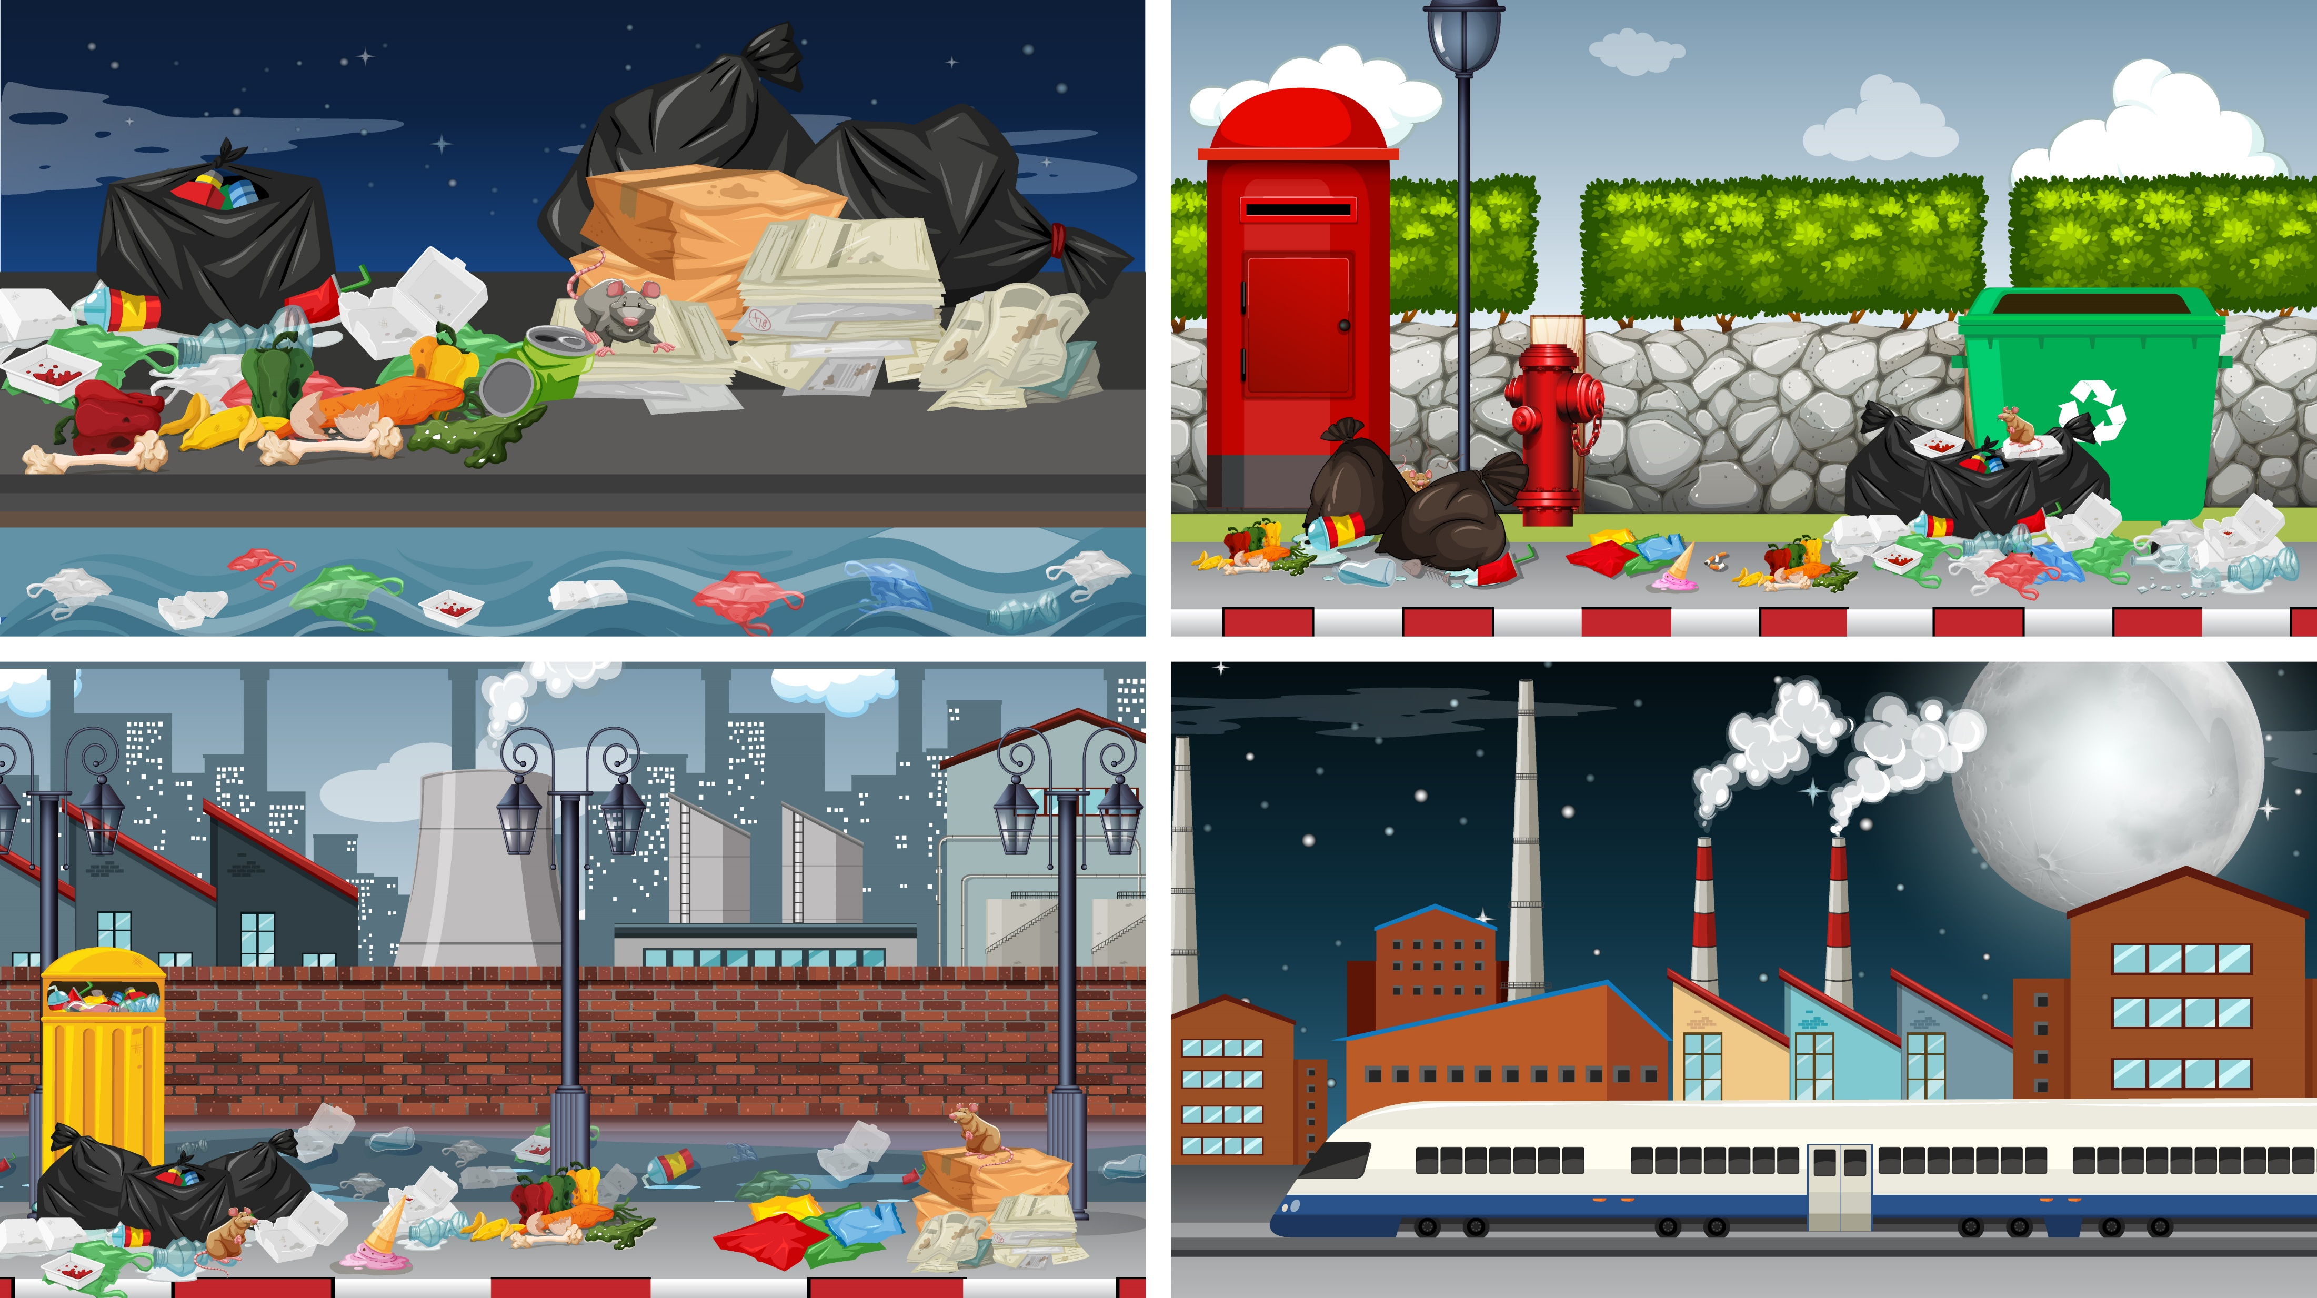

Title: Environment Pollution Subtitle: Understanding the Causes, Effects, and Solutions
Presented By :
Md. Obaidul Hoque Tarek

Slide 2
Introduction to Environmental Pollution
Definition: Environmental pollution is the contamination of the natural environment by harmful substances or pollutants.
Types of Pollution: Air, Water, Soil, Noise, and Light pollution.
Image: Diagram or icons showing different types of pollution.

Slide 3

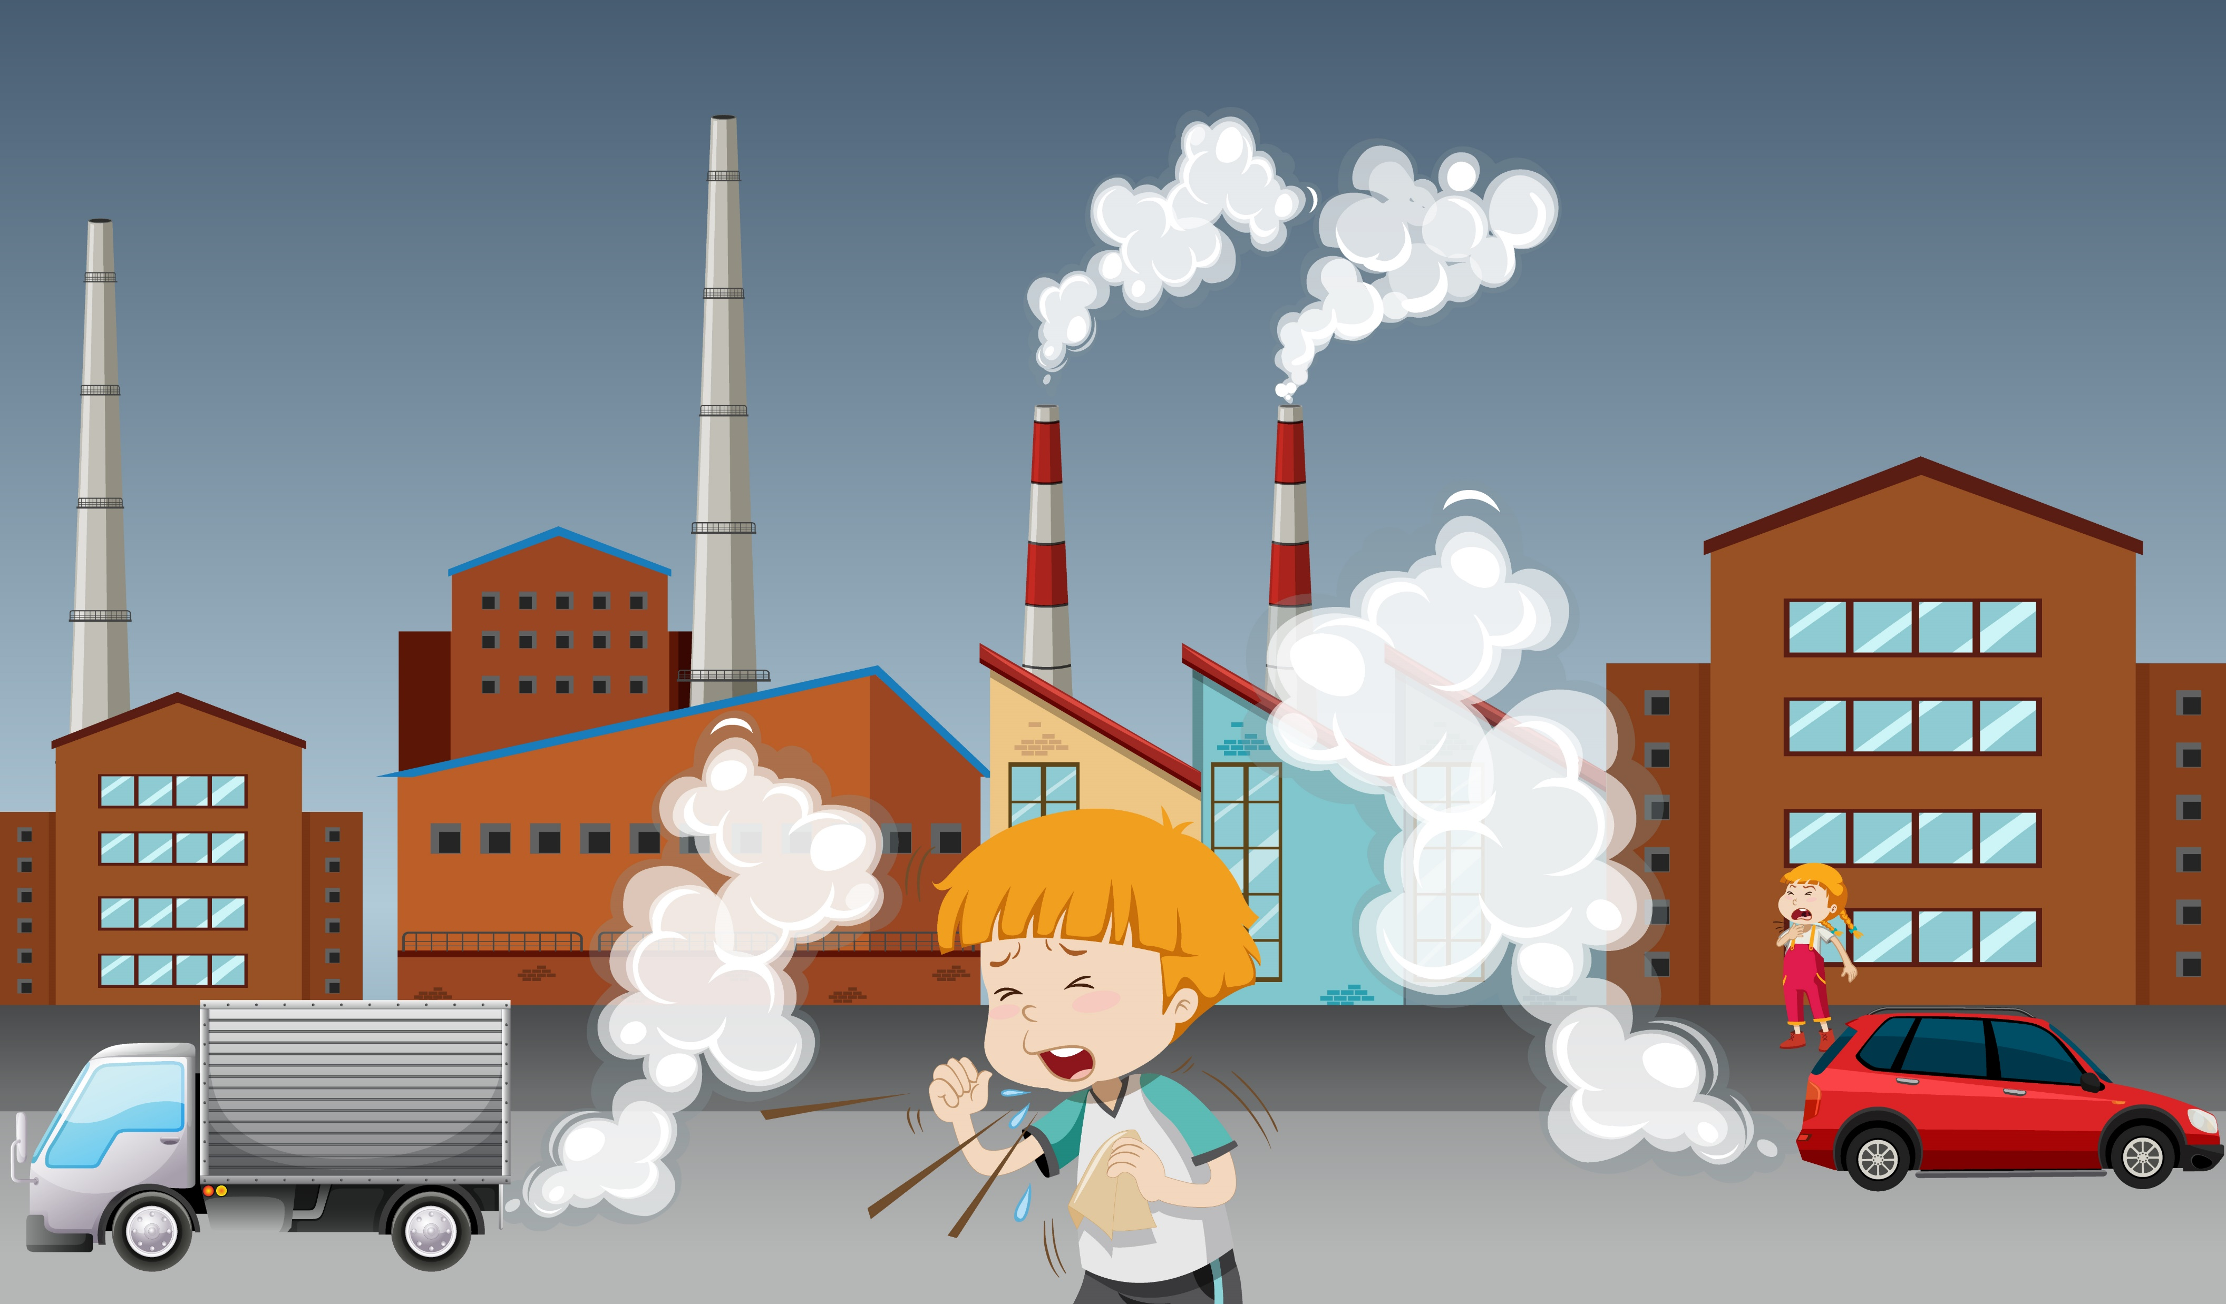
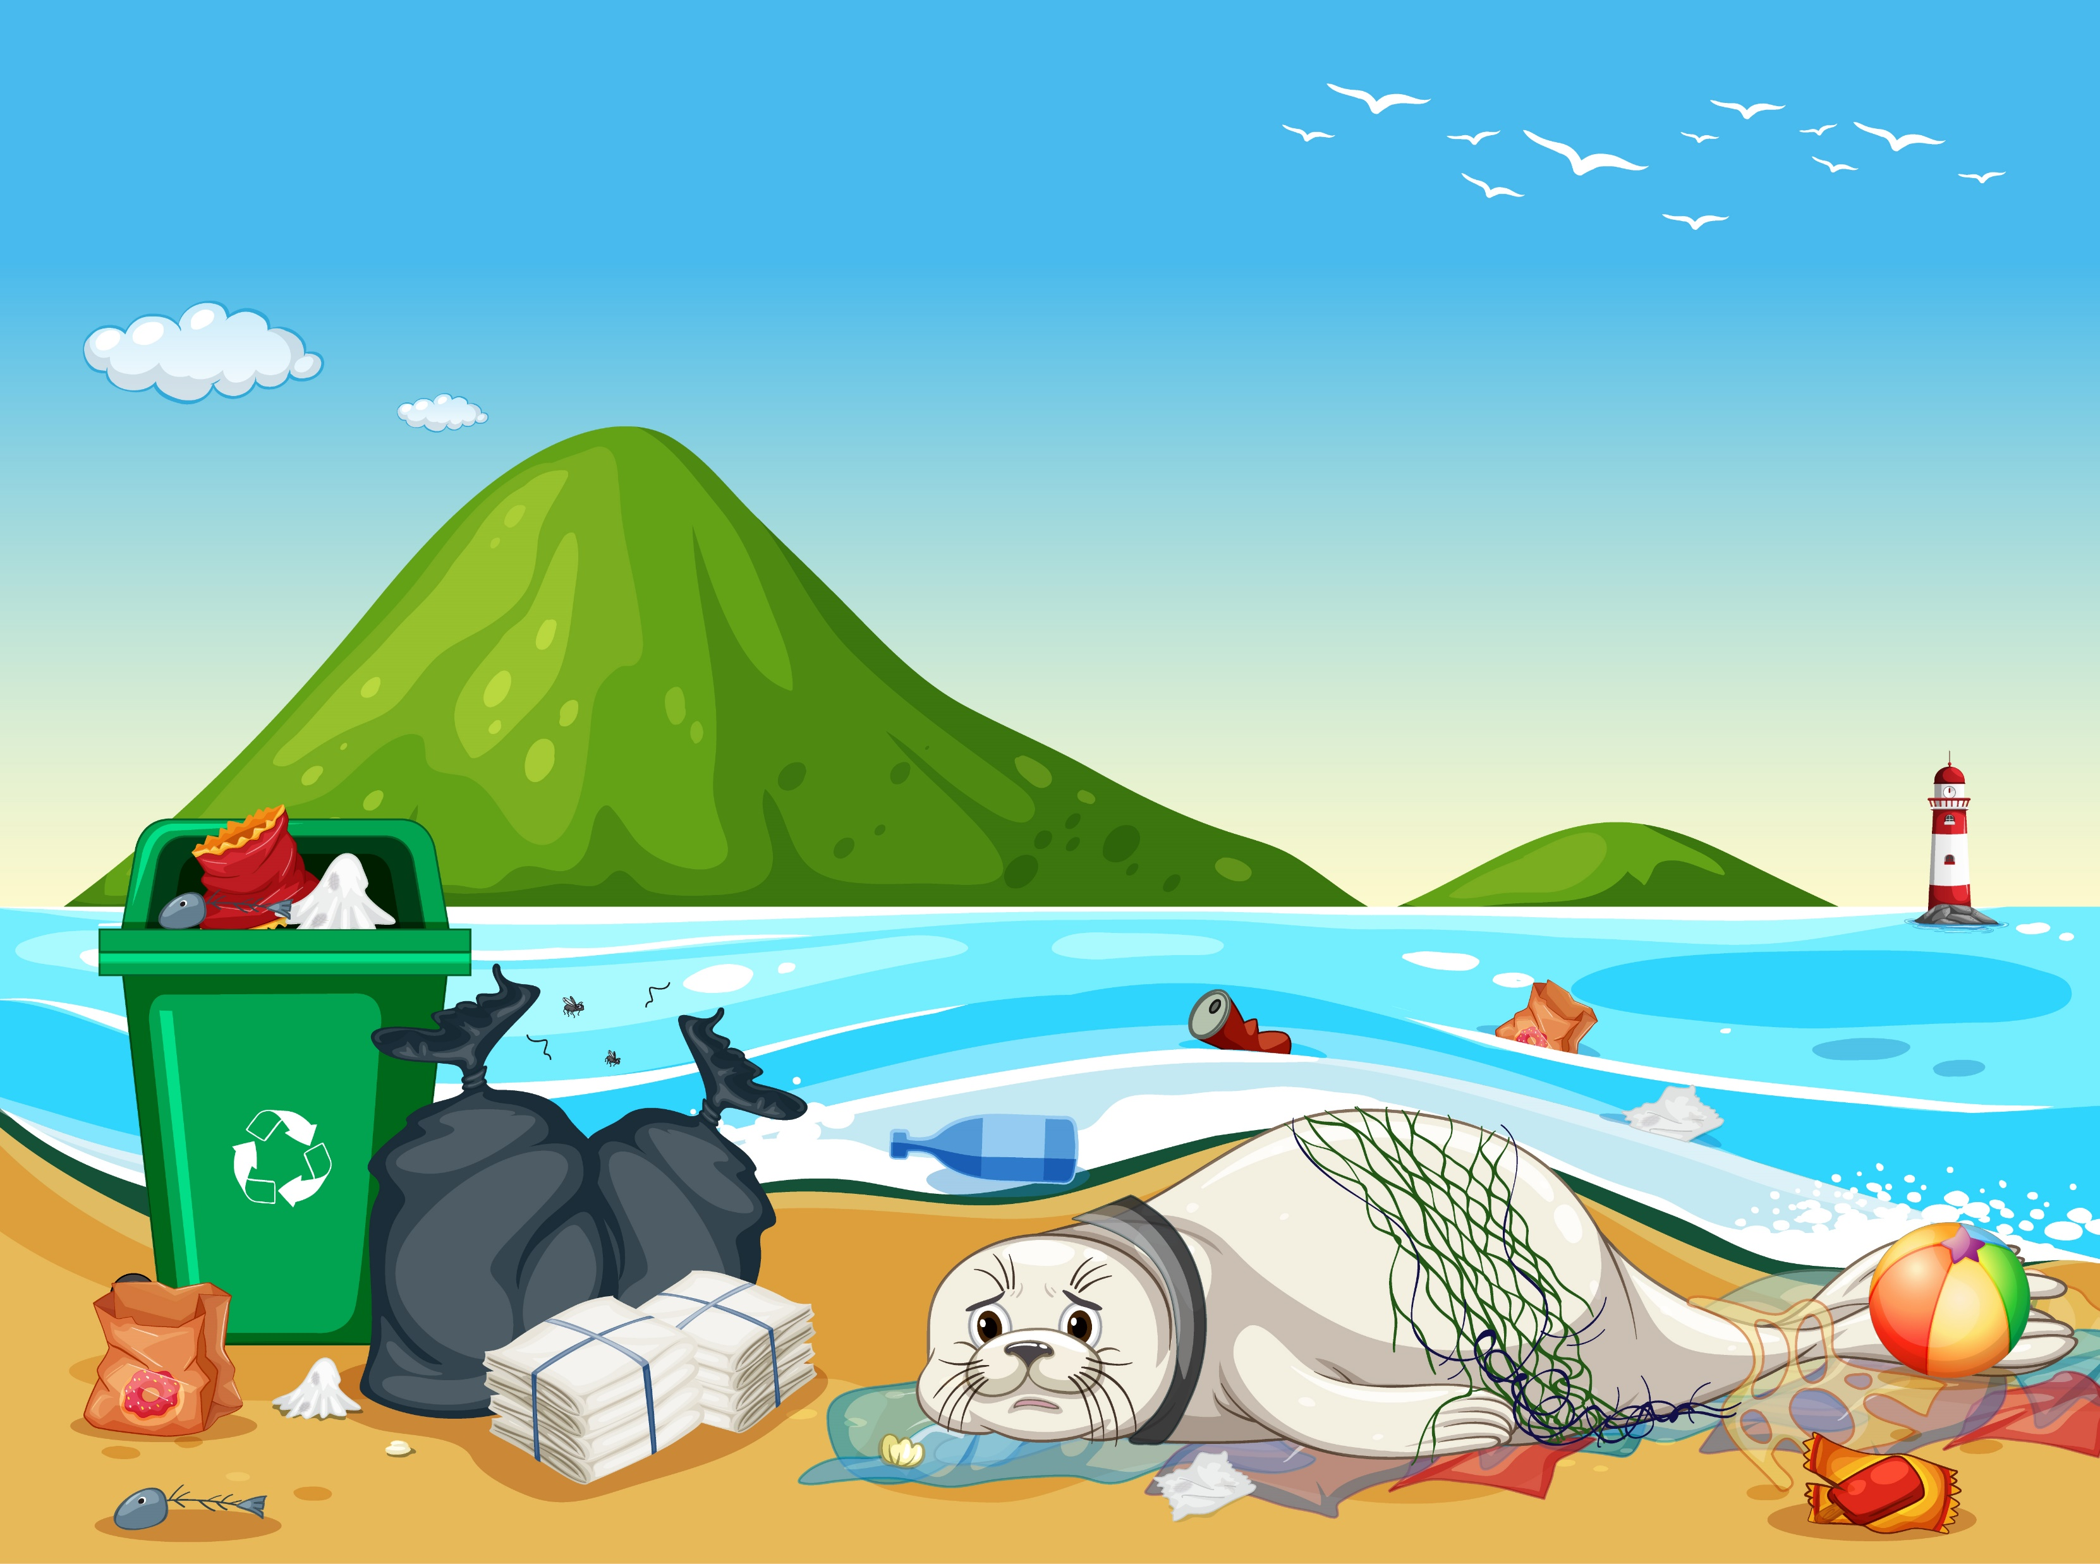
Causes of Environmental Pollution
Industrial Activities: Factories releasing toxic gases and chemicals.
Vehicle Emissions: The release of carbon dioxide and other pollutants into the air.
Waste Disposal: Improper disposal of solid and hazardous waste.
Agricultural Practices: Pesticides and fertilizers leaching into the soil and water.
Factory smoke stacks
vehicle exhaust
plastic waste

